Slide 1
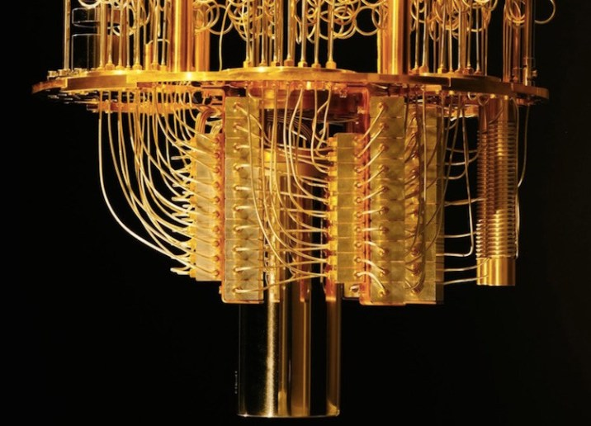
Quantum
Computing

Slide 2

Contents
Need of Quantum Computing
Understanding Qubits
Qubit Manipulation
Applications of Quantum Computing
Quantum Algorithms
Problems ahead of Quantum Computing
Conclusion

Slide 3
Need of Quantum Computing
we are approaching a real physical barrier for our technological process
90
80
70
60
Transistor Size (nm)
50
40
30
20
Current system
1
0
0
Approx 0 nm
(Atom Size)
Time

Slide 4
Quantum Tunneling
STEP
STEP
STEP
Electron Wave
1
Energy Barrier
2
Transistor
3
Electron Wave
Quantum Picture
If the barrier is thin enough the object may pass through it. The thinner, the barrier is, the more likely the chance of object to pass through it.

Slide 5

Qubits
Quantum Bits which is also called Qubits is the basic unit of Quantum Computers.
Qubits can be in 0 or 1 state or both at a same time.

Slide 6


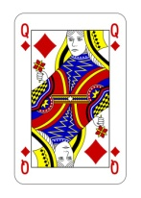
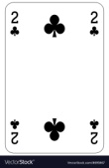

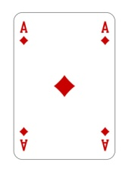
Four - Card Monte Game
1
0
1
0
00 01 10 11
00 01 10 11
Classical Bits
Quantum Bits

Slide 7
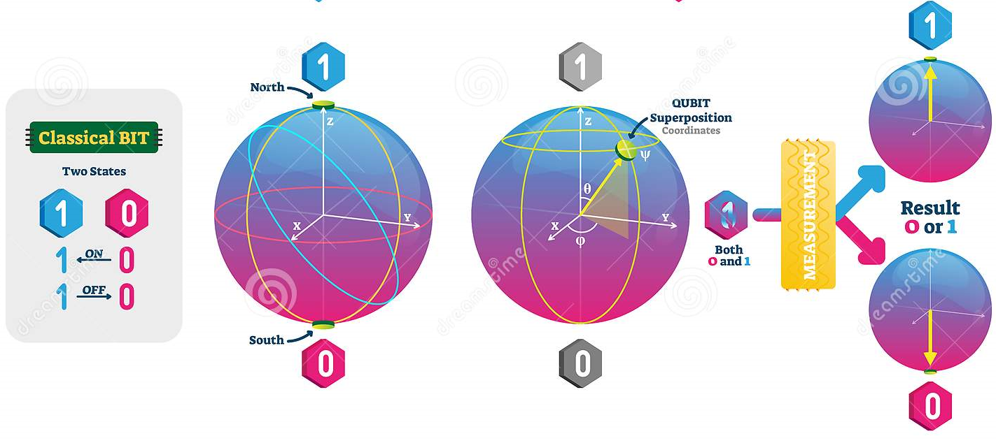
Quantum Superposition

Slide 8
Quantum Entanglement
1
1
Qubits can be entangled to each other by laser process
0
0

Slide 9
Quantum Entanglement
1
Once Qubits are entangled it doesn’t matter how far they are to each other they can still predict the state of there Qubit partner
1
0
0

Slide 10
Quantum Entanglement
0
Measuring just one entangled Qubit , you can directly deduce the properties of it’s partner
1

Slide 11
Qubits
Manipulation
AND
OR
NOT
NAND
Simple Logic Gates

Slide 12
Qubits
Manipulation
1
1
0
0
Superposition
Quantum Gates
Superposition
Quantum Logic Gates

Slide 13
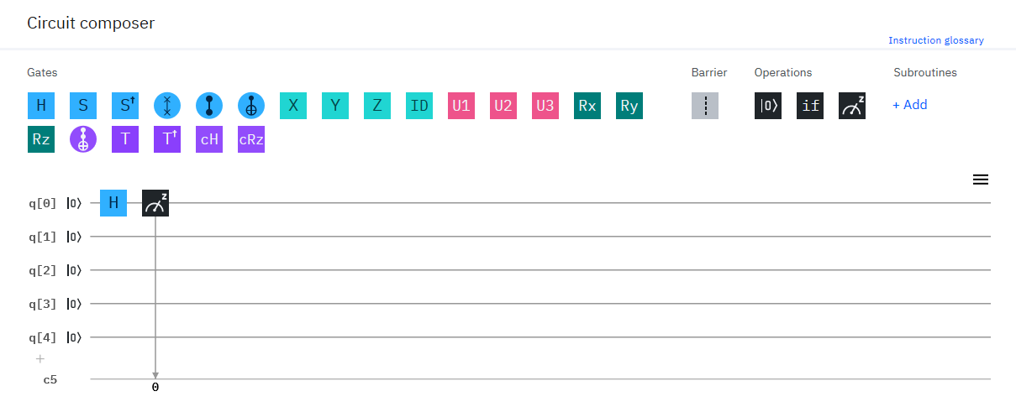
Circuit Diagram Of Quantum Logic Gates

Slide 14
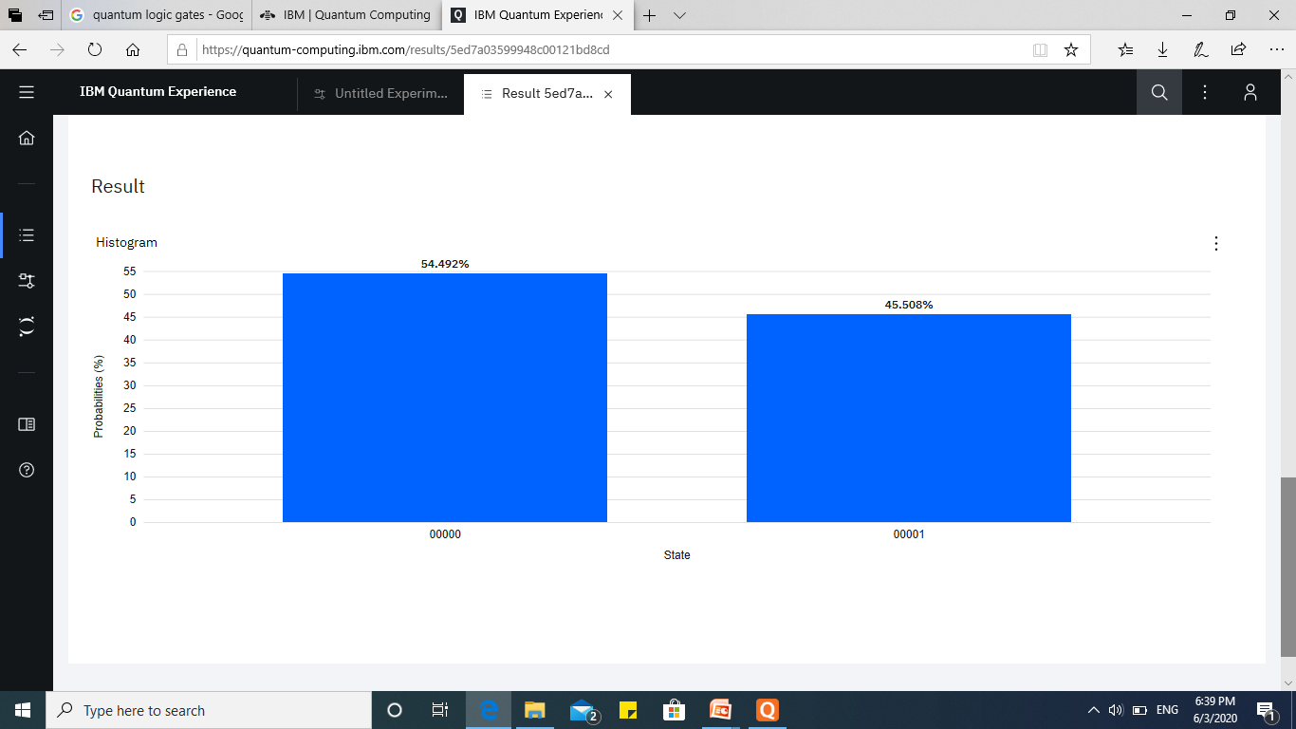
Result of Circuit Diagram After 1ST Run

Slide 15
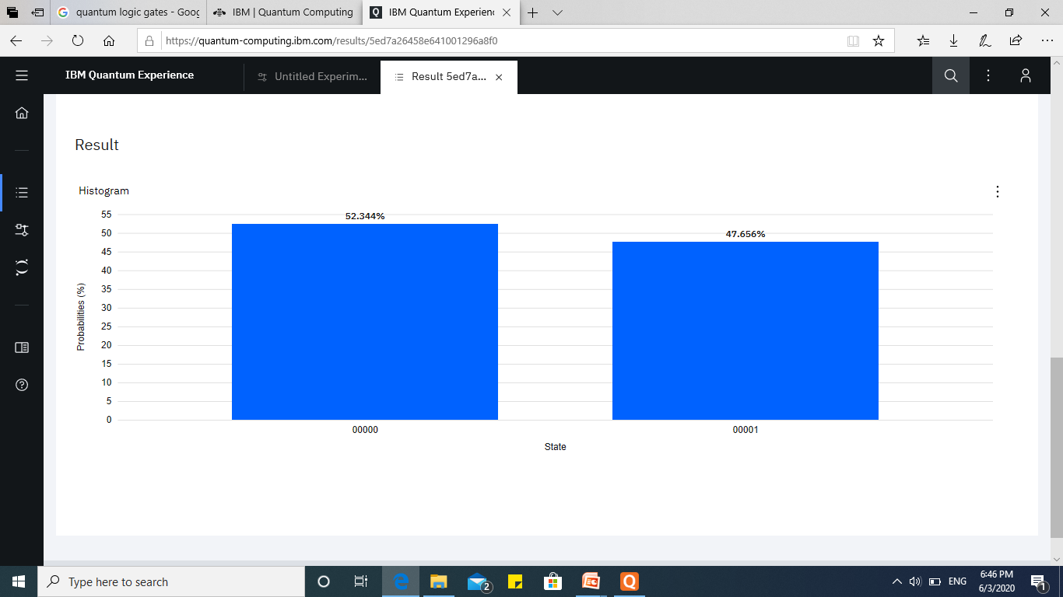
Result of Circuit Diagram After 2nd Run

Slide 16





Quantum Computing Impact On Application & Industries
Weather Services
Machine Learning
Cryptography
Pharmaceutical
Financial Services

Slide 17
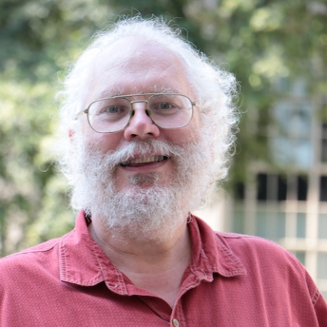
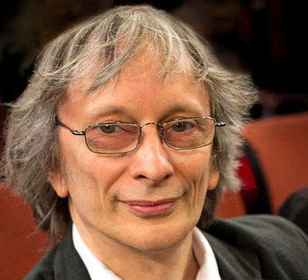

Quantum Algorithms
A quantum algorithm is a step-by-step procedure, where each of the steps can be performed on a quantum computer.
Peter Shor’s
Deutch Jozas
Lov Grover
Shor's algorithm solves the integer factorization problem in polynomial time.
The Deutsch–Jozsa algorithm solves a black-box problem.
Grover's algorithm, takes O(N1/2) time, is the fastest possible way to search an unsorted database.

Slide 18
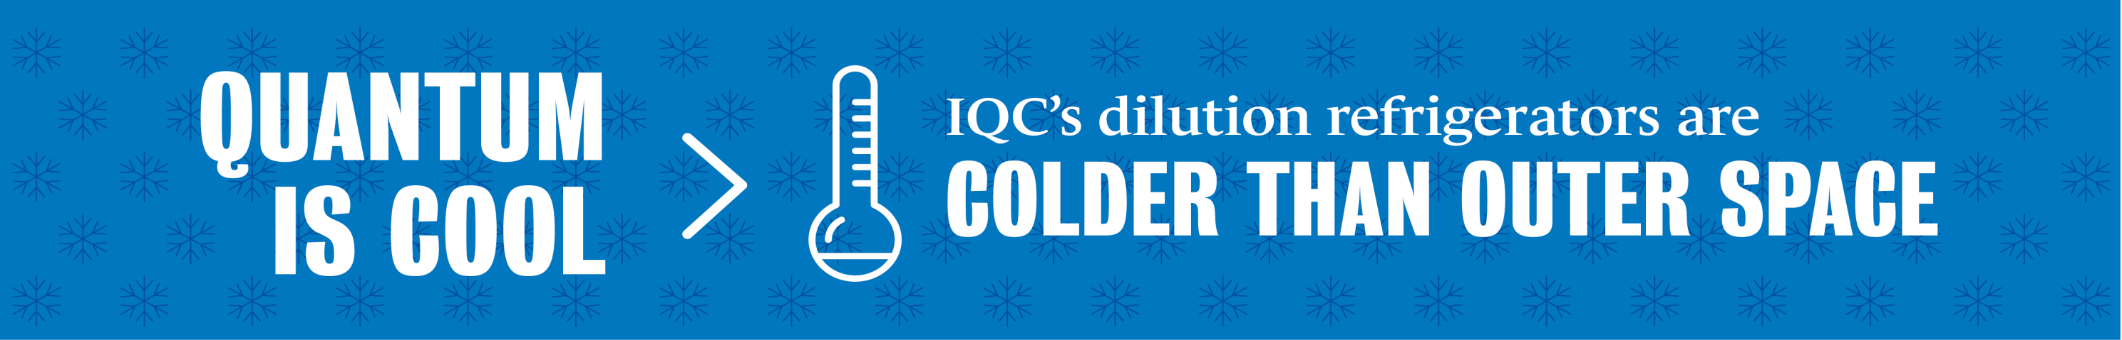
Problems with Quantum Computing
01
Interference
The slightest disturbance in a quantum system causes the quantum computation to collapse, a process known as de-coherence.
02
Error Correction
A single error in a quantum calculation can cause the validity of the entire computation to collapse.
03
Output Observance
Observing the Qubits will soon lead it to loose heat and create noise
which can corrupt the resultant output data.
04
Adding More Qubit Is Not Simple
More Qubits added to system will not help us to improve error rate and also increase the interference rate leading us to more problems.

Slide 19
Conclusion
The age of quantum computing is earlier than expectations of scientist
Quantum Computing can solves previous unapproachable problems.
Still more research & development needed in quantum technology
Need to build a large fault-tolerant quantum computer
Some significant technological & concept issue need to be resolve first.
Organization need to start preparing them- selves from quantum threats.
Experts of quantum technology field need
to educate others
Organizations are coming closer to achieve quantum supremacy

Slide 20
References
https://www.qubit.org
https://www.microsoft.com/en-us/quantum
https://www.dwavesys.com/quantum-computing
https://en.wikipedia.org/wiki/Quantum_computing
https://hackernoon.com/quantum-computing-explained
https://research.google/teams/applied-science/quantum
https://www.ibm.com/quantum-computing/learn/what-is-quantum-computing
https://www.freecodecamp.org/news/what-is-a-quantum-computer-explained-with-a-simple-example

Slide 21
Thanks !
If you are not completely confused by quantum mechanics then you do not understand it.

